Slide 1
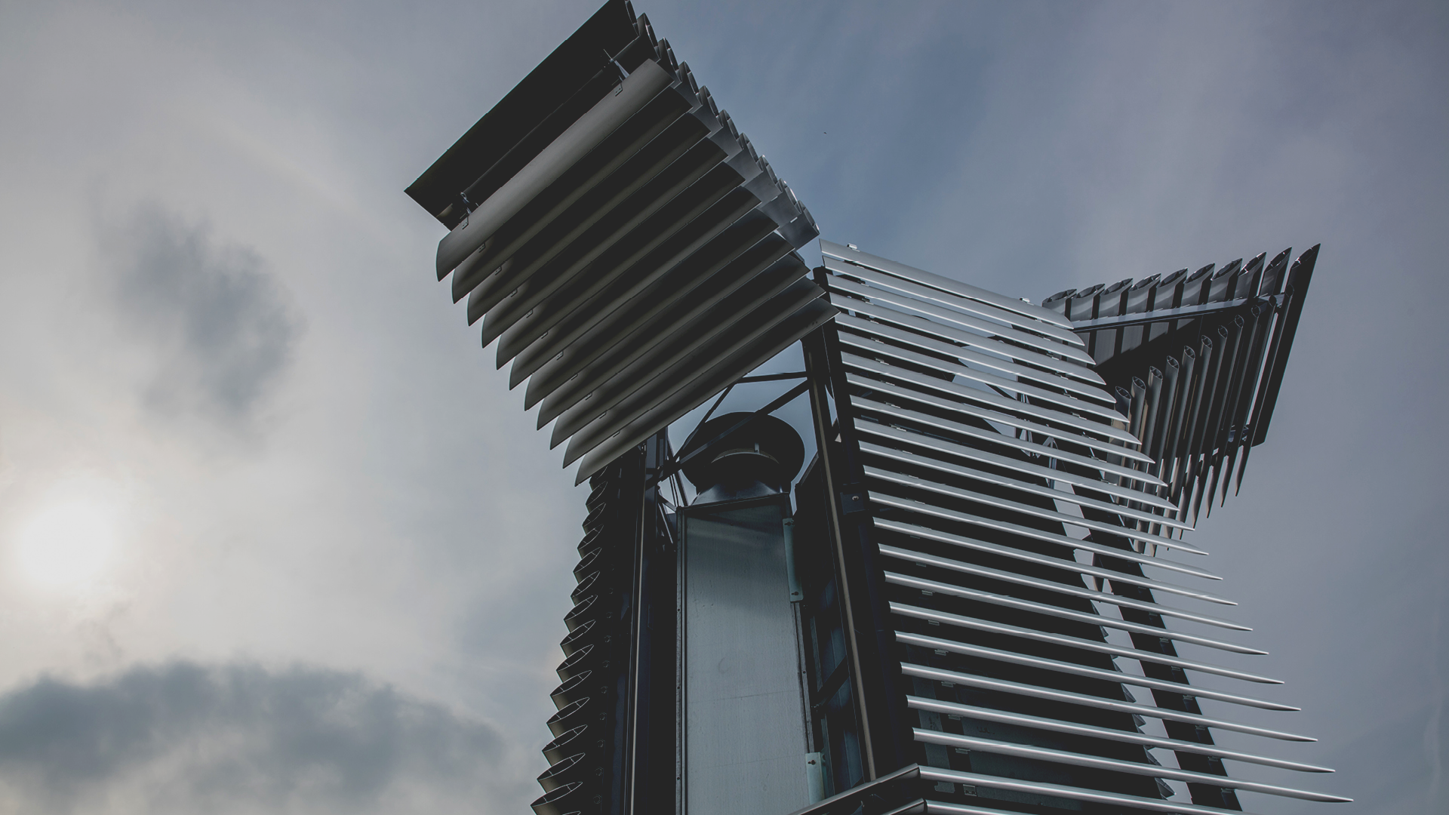
PROPOSAL REFERENCE NO : BT/EF0059/01/22
E-YUVA CENTRE : ADAMAS UNIVERSITY​
SMOG FILTER
An Intense Field Dielectric-based Smog Filter Design

Slide 2

APPLICANT PROFILE
TEAM MEMBER DETAILS :
MENTOR DETAILS :
ANUSHKA SHARMA
MD ASIF HASSAN
Dept. of EEE, BIT
ADITYA AVI
ANKIT RAJ
ADITYAM RAJ
AMAN KUMAR

Slide 3
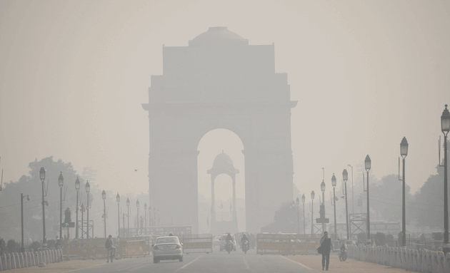
PROBLEM STATEMENT
The atmosphere is awash with varied harmful elements viz particulate matter, toxic emissions and VOCs.
The hazardous smog encompassing such detrimental particles makes it difficult to breathe in followed by deadly health hazards.
Developed countries have measures for unemployment, financial bottlenecks and hygiene but no programs to facilitate the supply of pure air.
A vast section of the population suffering from asthma, cardiovascular disease, neurological disorders and cancer,

Slide 4
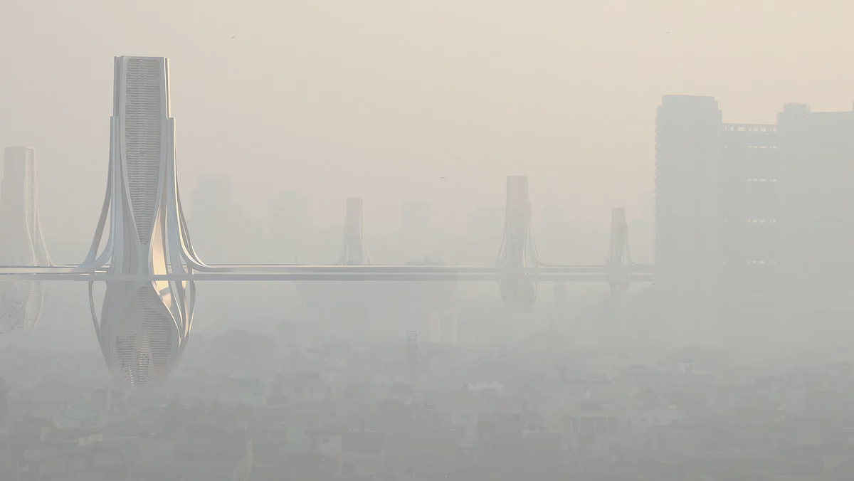
Proposed Solution
To counter the adverse effects of the contaminated air, we have proposed an Intense Field Dielectric based smog filter that works on the principle of electrostatic precipitation and has an efficiency of 99.99 %.
An iFD Smog filter makes use of electric current to assist the removal of particulate pollution from the air.
It filter works like a magnet as it attracts particulate matter while undergoing the process of cleansing of air and uses electricity to decimate the hazardous pollutants.
The mechanism that we use is broadly classified into 3 parts:
1. Infusing electric charge into the air
2. Passing air through the filter
3. Capture of pollutants by filter

Slide 5
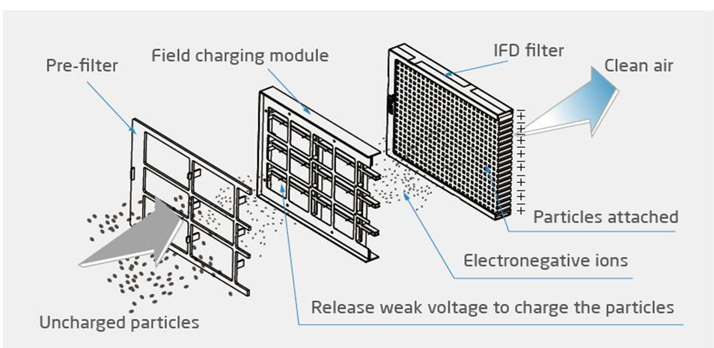

Slide 6
Why iFD Filters?
The existing SMOG Filter in Delhi uses the HEPA mechanism and a huge initial cost as well as maintenance cost.
The ifD filter is revolutionary because unlike HEPA filters it never needs to be replaced as it is a permanent and washable air purification filter.
It would not only exceed the efficiency of a smog tower but also reduce its maintenance cost of it.
Being a washable filter, it is much easier to clean than the regular HEPA filters, which in turn, makes it more affordable and less maintenance.
Also, there is a minimal amount of energy consumption that makes it sustainable for the posterity as well.

Slide 7

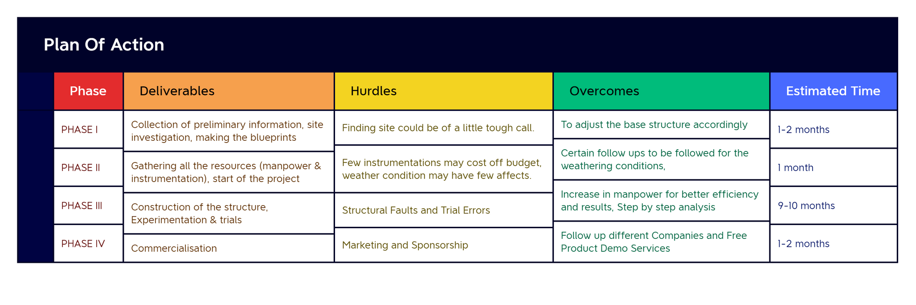
WORKPLAN

Slide 8


BUDGET DISTRIBUTION
COST STRUCTURE
Structural Cost = 30K
The cost comprising the basic structure of the filter
Total Filter Cost = 20K
ifD Filter + Tree Filter + Activated Carbon Filter Costs
Trial & Experimental Cost = 20K
Miscellaneous Cost = 20K
Labour Cost
10K per filter

Slide 9

TEAM STRENGTH
Strong core fundamentals in electrical and technical aspects.
Innovative and Open minded people with the mindset of an iterator.
We're a consistent bunch and we produce output.

